Slide 1
Wanted/Hero Poster
Your Task: Create a Wanted/Hero poster for a figure from Ancient Rome.
If you consider the person to be a villain you will create a Wanted poster.
If you think the person was good you will create a Hero poster.
www.deborahbradburybooks.com

Slide 2
Your poster must include all of the following:
1. A sketch of what the person probably looks like.
2. A reward amount listing the specific crime or heroic action the person did.
3. A made-up quote from a person living at the time showing what people might have said about this person.
4. The approximate date this poster would have been found.
5. A written description of what the person has done in their life.

Slide 3


Remember the Old Western Cowboy Movies?

Slide 4


Super Hereo Posters

Slide 5
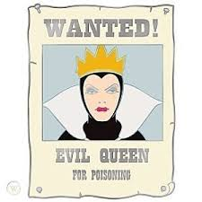
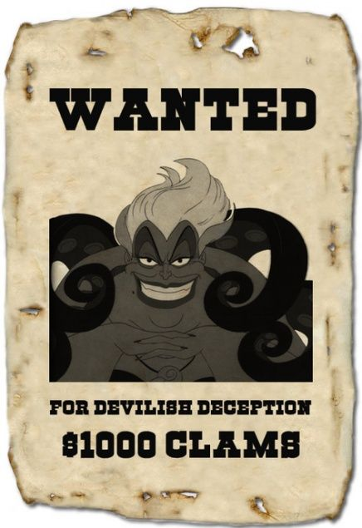
Villian Wanted Posters

Slide 6

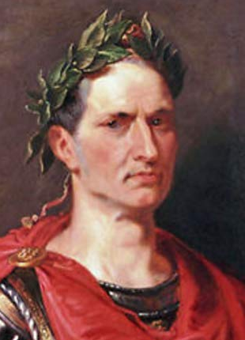
Google an image or draw one of your own!
Julius Caesar - Roman Leader
Wanted for crimes against the Republic of Rome and crucified 1000s!
Write something about what the person has done in their life.
Had a son with Cleopatra!
Kidnapped by pirates!
Write the date the poster would have been found.
100,000 denarius REWARD
60BC
Famous quote: “I came, I saw, I conquered.”
Add a famous quote or invent one.

Slide 7
Will it be a Villian or a Hero?
Emperors - Soldiers/Generals - Gods/Goddesses - Gladiators - Mythical Characters
Marcus Antonius Hercules Julius Caesar Juno
Pluto Nero Ben Hur Commodus
Venus Aeneas Romulus Spartucus

Slide 8
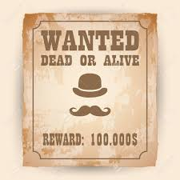
Who will you choose to be in your Wanted Villian /Hero Poster?
www.deborahbradburybooks.com

